Slide 1
Module 10: Well-Architected Pillar 2: Security
Notes:
Welcome to Module 10, where you will learn about the second pillar of the Well-Architected Framework: Security.
This module discusses many best practices, and you will learn how to secure data at every layer in the application. This module also mentions the following tools and services from Amazon Web Services—or AWS—that provide security-focused content:
• AWS Identity and Access Management, or IAM
• AWS Organizations
• Multi-factor authentication (MFA) token
• AWS CloudTrail
• AWS Config
• Amazon CloudWatch
• Amazon GuardDuty
• Amazon Virtual Private Cloud, or Amazon VPC
• Amazon Inspector
• AWS Shield
• AWS WAF
• Amazon Macie
• AWS Key Management Service, or AWS KMS
• Amazon Simple Storage Service, or Amazon S3
• Amazon Elastic Block Store, or Amazon EBS
• And AWS CloudFormation

Slide 2

What’s In This Module
Part 1: Principles of the Security Pillar
Part 2: Preventing Common Security Exploits
Part 3: Securing Data in CloudFront
Part 4: Encrypting Data
Part 5: Authentication
Module 10 Lab: Introduction to Amazon CloudFront
Notes:
In part 1, you will review principles of the security pillar.
In part 2, you will learn how to prevent common security exploits.
In part 3, you will learn how to secure data in CloudFront.
In part 4, you will learn about encrypting your data.
In part 5, you will review best practices for authentication.
We highly recommend that instructors familiarize themselves with the AWS KMS Cryptographic Details whitepaper by selecting the link.
https://d1.awsstatic.com/whitepapers/KMS-Cryptographic-Details.pdf

Slide 3
Module Objectives
Upon completing this module, you will:
Describe how to secure data at every layer in the application and identify the appropriate tools and services to provide security focused content.
Identify the design principles and best practices of the Security pillar.
Notes:
Upon completing this module, you will be able to:
Describe how to secure data at every layer in the application and identify the appropriate tools and services to provide security focused content.
Identify the design principles and best practices of the Security pillar.

Slide 4
Principles of the Security Pillar
Notes:
Let’s review the principles of the Well-Architected Framework Security pillar.

Slide 5

Well-Architected Pillar 2: Security
The ability to protect information, systems, and assets while delivering business value through risk assessments and mitigation strategies.
Identity and access management
Detective controls
Infrastructure protection
Data protection
Incident response
Notes:
The goal of the Security pillar is to keep the impact of any type of failure to the smallest possible area. By preparing your system for the worst, you can implement a variety of mitigation strategies for the different components of your infrastructure and applications. Before a failure occurs, you want to test your recovery procedures. To reduce the possibility of human error, it is important to try to automate recovery as much as possible.
Mitigation strategies include:
• Identity and access management
• Detective controls
• Infrastructure protection
• Data protection
• And incident response

Slide 6

Security: Design Principles
Implement a strong identity foundation.
Enable traceability.
Apply security at all layers.
Automate security best practices.
Protect data in transit and at rest.
Prepare for security events.
Notes:
In the cloud, you can follow several design principles that can help you strengthen the security of your system.
You should implement a strong identity foundation with the principle of least privilege. You should also enforce the separation of duties, and make sure that you grant appropriate authorization for each interaction with your AWS resources. You can centralize privilege management, and reduce—or even eliminate—reliance on long-term credentials.
Another design principle for security is to enable traceability with monitoring, using alerts, and auditing actions or changes to your environment in real time. You can integrate logs and metrics with your systems so that they can automatically respond to incidents and take action.
You should also apply security at all layers. Instead of running security appliances only at the edge of your infrastructure—such as firewalls—use security controls on all of your resources. For example, you can implement security controls on every virtual server, load balancer, and network subnet.
You should automate your best practices for security. Automated software-based security mechanisms improve your ability to scale in a more secure, rapid, and cost-effective way. You can create and save a patched, hardened image of a virtual server, and then use that image automatically on each new server you launch. You can also create an entire trust zone architecture that is defined and managed in a template via revision control. The final aspect of automating security is to automate the response to both routine and anomalous security events.
Another design principle is to protect your data in transit and at rest. Classify your data into sensitivity levels and use mechanisms, such as encryption and tokenization, where appropriate. You can reduce or eliminate direct human access to data to reduce the risk of loss or modification.
The final design principle for security is to make sure that you prepare for security events and incidents by having an incident management process that aligns to your organizational requirements. Run incident response simulations, and use tools with automation to increase your speed for detection, investigation, and recovery.

Slide 7
















Key Services for Security
Areas | Key Services
Identity and Access Management
Detective Controls
Infrastructure Protection
Data Protection
Incident Response
AWS IAM
AWS Organizations
MFA Token
Temporary Security Credential
AWS IAM
AWS CloudTrail
Amazon
CloudWatch
Amazon
GuardDuty
AWS Config
Amazon VPC
Amazon Inspector
AWS Shield
AWS WAF
Amazon Macie
AWS KMS
Amazon S3
Amazon EBS
AWS IAM
AWS CloudFormation
Notes:
This slide shows key AWS services for security. The AWS service that is essential to security is AWS Identity and Access Management, or IAM, which allows you to securely control access to AWS services and resources for your users. A multi-factor authentication—or MFA—token adds an extra layer of protection on top of your user name and password.
Detective Controls include AWS CloudTrail, which records application programming interface, or API, calls to AWS services. AWS Config provides a detailed inventory of your AWS resources and configuration, and Amazon CloudWatch is a monitoring service for AWS resources.
Infrastructure Protection includes Amazon VPC, which lets you provision a private, isolated section of the AWS Cloud. You can then launch AWS resources in this virtual network.
Data Protection includes services such as Elastic Load Balancing, or ELB; Amazon Elastic Block Store, or Amazon EBS; Amazon S3; and Amazon Relational Database Service, or Amazon RDS. These services provide encryption capabilities that protect your data in transit and at rest. Amazon Macie automatically discovers, classifies, and protects sensitive data, and you can use AWS Key Management Service—or AWS KMS—to create and control keys that are used for encryption.
Incident Response includes IAM, which should be used to grant the appropriate authorization to incident response teams. AWS CloudFormation can also be used to create a trusted environment for conducting investigations.

Slide 8
Preventing Common Security Exploits
Notes:
Let’s discuss how to prevent common security exploits.

Slide 9
Distributed Denial of Service Attacks
A Denial of Service (DoS) attack attempts to make your website or application unavailable to your end users.
A Distributed Denial of Service (DDoS) attack combines the efforts of numerous systems to simultaneously attack your website or application.
To achieve this, attackers use a variety of techniques that consume network or other resources, thus interrupting access for legitimate end users.
The attackers use multiple hosts to orchestrate an attack against a target.
Notes:
A distributed denial of service—or DDOS—attack attempts to make your website or application unavailable to your end users.
A DDOS attack combines the efforts of numerous systems to simultaneously attack your website or application.
To achieve this, attackers use a variety of techniques that consume your network or other resources, thus interrupting access for legitimate end users.
The attackers use multiple hosts to orchestrate an attack against a target.
Select the link to view the presentation on DDOS resilience with Amazon Web Services.
http://www.slideshare.net/AmazonWebServices/ddos-resiliency-with-amazon-web-services-sec305-aws-reinvent-2013

Slide 10
DDoS Protection
Protecting against attacks is a shared responsibility between AWS and you.
AWS
Customer
AWS API endpoints are hosted on large, Internet-scale, world-class infrastructure.
Proprietary DDoS mitigation techniques are used.
AWS networks are multi-homed across a number of providers to achieve Internet access diversity.
Front your application with AWS Services
Safeguard exposed resources
Minimize the attack surface
Evaluate soft limits and request increases ahead of time
Learn normal behavior
Create a plan for attacks
Notes:
Protecting against attacks is a shared responsibility between AWS and you.
DDOS is a type of denial of service, or DOS, attack where multiple compromised systems are used to target a single system. The compromised systems are typically infected with Trojans. Victims of a DDOS attack consist of both the end targeted system, and all systems that are maliciously used and controlled by the hacker in the distributed attack.
• AWS uses API endpoints that are hosted on a large, internet-scale, world-class infrastructure.
• We have—and use—proprietary DDOS mitigation techniques.
• And our AWS networks are multi-homed across a number of providers to achieve diversity of internet access.
As a customer, you want to:
• Secure your applications with AWS services
• Safeguard exposed resources
• Minimize the attack surface
• Evaluate soft limits and request increases ahead of time
• Learn normal behavior
• And create a plan for attacks
For example, some services such as Amazon S3, use a shared infrastructure. This means that multiple AWS accounts access and store data on the same set of Amazon S3 infrastructure components. In this case, a DOS or DDOS attack on abstracted services will probably affect multiple customers. We provide both mitigation and protection controls on abstracted services to minimize the impact to you when a DOS or DDOS attack occurs. You are not required to provide additional DOS or DDOS protection of these services, but we do advise that you follow the best practices that are outlined in the AWS Security Best Practices whitepaper.
Go to the link to download the AWS Security Best Practices whitepaper:
https://aws.amazon.com/whitepapers/aws-security-best-practices

Slide 11









DDoS Mitigation Example
DDoS
Amazon
CloudFront
AWS WAF
Amazon EC2 instances
ELB
ELB security group
Web application security group
Public subnet
Users
Amazon Route 53
Amazon
API Gateway
Private subnet
Notes:
Displayed is an example of a resilient architecture that can help to prevent or mitigate DDOS attacks.
The strategy for minimizing the attack surface area first reduces the number of necessary internet entry points. It then eliminates non-critical internet entry points, and separates end user traffic from the management traffic. The strategy also obfuscates any necessary internet entry points so that untrusted end users cannot access them. Finally, it decouples internet entry points to minimize the effects of the attacks. This strategy can be accomplished with Amazon VPC.
Within AWS, you can take advantage of two forms of scaling: horizontal scaling and vertical scaling. In terms of DDOS, you can take advantage of scaling in AWS in three different ways. First, select the appropriate instance types for your application. Next, configure services such as Elastic Load Balancing and Amazon EC2 Auto Scaling to automatically scale your resources. Finally, use the inherent scale that is built into the AWS global services, like Amazon CloudFront and Amazon Route 53.
The classic load balancer from ELB only supports valid Transmission Control Protocol-or TCP-requests. Because of this feature, DDOS attacks such as User Datagram Protocol-or UDP-floods and SYN floods cannot reach your instances. You can set a condition to incrementally add new instances to the Auto Scaling group when network traffic is high, which is typical of DDOS attacks.
To learn more about the various types of ELB load balancers-which are application load balancers, network load balancers, and classic load balancers-select the link. https://aws.amazon.com/elasticloadbalancing/
You can use services that are available within AWS Regions-such as ELB and Amazon Elastic Compute Cloud, or Amazon EC2-to build DDOS resiliency and scale that can handle unexpected volumes of traffic within a given Region. Services that are available in AWS edge locations-like Amazon CloudFront, AWS WAF, Amazon Route 53, and Amazon API Gateway-allow you to take advantage of a global network of edge locations. You can use these edge locations to provide your application with greater fault tolerance and increased scale for managing larger volumes of traffic.
Amazon CloudFront also has filtering capabilities, which help ensure that only valid TCP connections and HTTP requests are made. It can also drop invalid requests.
A WAF-or web application firewall-is a tool that applies a set of rules to HTTP traffic. These rules filter web requests based on data such as IP addresses, HTTP headers, HTTP body, or uniform resource identifier-or URI-strings. Web application firewalls can be useful for mitigating DDOS attacks by offloading illegitimate traffic.
Select the link for more information on the AWS Best Practices for DDoS Resiliency whitepaper.
https://d0.awsstatic.com/whitepapers/Security/DDoS_White_Paper.pdf

Slide 12

Amazon Inspector
Is a Automated security assessment service that assesses applications for:
Vulnerabilities
Deviations from best practices
Produces a detailed report with prioritized steps for remediation after performing the assessment.
Notes:
Amazon Inspector automatically assesses applications for vulnerabilities and deviations from best practices. After performing an assessment, Amazon Inspector produces a detailed report with prioritized steps for remediation.
Application testing is key to moving fast, but staying safe can be challenging. Security assessments are highly manual, which can result in delays or missed security checks. Valuable security subject matter experts are spending too much of their time on route security assessments. Amazon Inspector can help in these areas.
Select the link to learn more about Amazon Inspector.
https://aws.amazon.com/inspector/

Slide 13


Amazon Inspector Rules
Amazon Inspector includes a knowledgebase with hundreds of rules that are
Mapped to:
Common security compliance standards
Vulnerability definitions
Regularly updated by AWS security researchers.
Examples of Built-In Rules
Remote root login being enabled
Vulnerable software versions installed
Notes:
To help you get started quickly, Amazon Inspector includes a knowledge base with hundreds of rules that are mapped to common security compliance standards and vulnerability definitions. These rules are regularly updated by AWS security researchers.
Examples of built-in rules that you can use in Amazon Inspector to send notifications include checking for whether remote root login is enabled, and whether vulnerable software versions are installed.

Slide 14
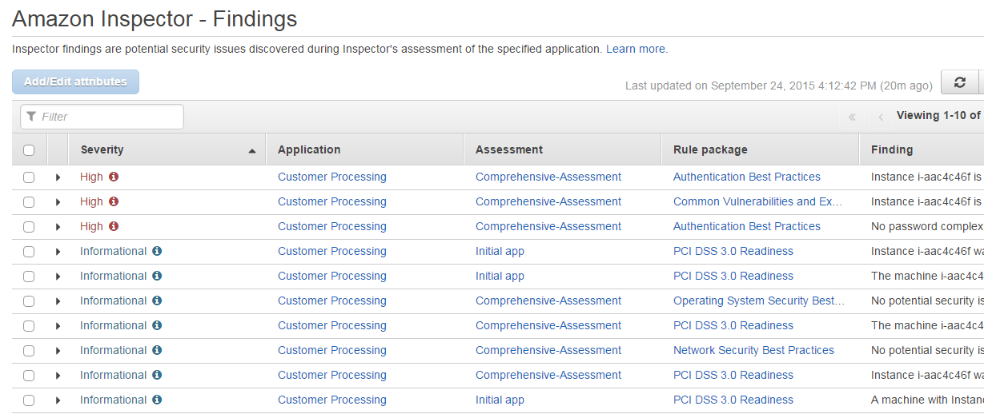
Prioritized List of Findings
Notes:
Displayed is an example of findings from Amazon Inspector, which prioritizes the list by severity.
Findings are potential security issues that are discovered during the Amazon Inspector’s assessment of the selected assessment target. Findings contain both a detailed description of the security issues and recommendations for how to solve them. The details of a specific finding include:
• The name of the assessment target, which includes the Amazon EC2 instance where this finding was registered
• The name of the assessment template that was used to produce this finding
• The assessment run start time, end time, and status
• The name of the rules package that includes the rule that triggered this finding
• The name of the finding
• The severity of the finding
• The description of the finding
• And remediation steps
Select the link to learn more about Amazon Inspector findings.
http://docs.aws.amazon.com/inspector/latest/userguide/inspector_findings.html

Slide 15
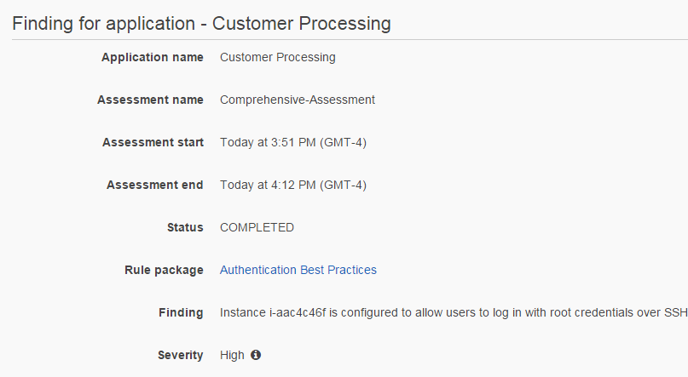
Remediation Recommendations
Notes:
Displayed is an example of a recommended remediation step that you could complete to fix the potential security issue that was described by the finding.
The remediation step information provides the name of the rule package, the when the scan was run, the time when the scan was completed, and specific information on the finding. In this high severity example, the remediation step information provides the instance ID, and it mentions that the root credentials are still allowed to login over Secure Shell, or SSH.

Slide 16

AWS Shield
Standard Protection
Advanced Protection
Available to ALL AWS customers at no additional cost
Paid service that provides additional protections, features, and benefits
Notes:
In addition to Amazon Inspector, we also offer AWS Shield, which comes in two options: AWS Shield Standard or AWS Shield Advanced.
AWS Shield Standard is available to all AWS accounts at no additional cost. AWS Shield Advanced is a pay-as—you-go service that provides additional protections, features, and benefits, such as expanded DDOS attack protection for your Amazon EC2 instances, ELB load balancers, CloudFront distributions, and Amazon Route 53 hosted zones.
To learn more information about AWS Shield and managed DDOS Protection, select the link. https://aws.amazon.com/shield/

Slide 17



Types of Threats
AWS Shield
DDoS
Application Attacks
Bad Bots
SQL injection
Sensitive data exposure
Application
Layer
Crawlers
Content scrapers
HTTP floods
Social engineering
Application exploits
Scanners & probes
Reflection
SSL abuse
Network/
Transport
Layer
Amplification
Slowloris
Layer 4 floods
AWS Shield
Notes:
Displayed are examples of the types of threats that an infrastructure might face. AWS Shield provides expanded protection against many types of attacks, such as HTTP floods on the application layer.
With an HTTP flood, including GET and POST floods, an attacker sends multiple HTTP requests that appear to be from a real user of the web application. Cache-busting attacks are a type of HTTP flood that uses variations in the HTTP request's query string. This type of attack prevents the use of edge-located and cached content. It forces the content to be served from the origin web server, which can cause additional and potentially damaging strain on the origin web server.
When you use AWS Shield along with AWS WAF, you also add protection for application attacks. Examples of these attacks include as SQL injection and bad bots that can produce crawlers or content scrapers.
As an AWS Shield Advanced customer, for example, you can contact a 24/7 DDOS response team for assistance during a DDOS attack. You also have exclusive access to advanced, real-time metrics and reports for extensive visibility into attacks on your AWS resources. With the assistance of the DDOS response team, AWS Shield Advanced includes intelligent DDOS attack detection and mitigation for network layer 3, transport layer 4, and even application layer 7 attacks.

Slide 18




Benefits of AWS Shield
AWS Integration
DDoS protection without infrastructure changes
Always-On Detection and Mitigation
Minimize impact on application latency
Affordable
Don’t force unnecessary trade-offs between cost and availability
Flexible
Customize protections for your applications
Notes:
The benefits of AWS Shield Standard include AWS integration for DDOS protection without having to change your infrastructure. Your AWS resources are automatically protected from the common, most frequently occurring network and transport-layer DDOS attacks. You can achieve a higher level of defense by using the AWS Management Console or API operations to enable AWS Shield Advanced protection for the Elastic IP, ELB, CloudFront or Route 53 resources that you want to protect.
AWS Shield Standard provides always-on network flow monitoring, which inspects incoming traffic to AWS. AWS Shield Standard uses a combination of traffic signatures, anomaly algorithms, and other analysis techniques to detect malicious traffic in real-time. Automated mitigation techniques are built-into AWS Shield Standard, which protects you against common, frequently occurring infrastructure attacks. Automatic mitigations are applied inline to your applications so that there is no impact on latency. Always-on detection and inline mitigation minimize application downtime, and you do not need to engage AWS Support to receive DDOS protection.
As an AWS customer, this protection is affordable because it does not require additional costs, resources, or time to initiate. With AWS Shield Advanced, you get "DDOS cost protection," which is a feature that protects your AWS bill from Amazon EC2, ELB, CloudFront and Route 53 usage spikes that result from a DDOS attack.
With AWS Shield Advanced, you have the flexibility to write customized rules to mitigate sophisticated application-layer attacks. These customizable rules can be deployed instantly, which allows you to quickly mitigate attacks. You can set up proactive rules to automatically block bad traffic or to respond to incidents as they occur. You can also engage the 24/7 AWS DDOS Response Team, who can write rules on your behalf to mitigate application layer DDOS attacks.

Slide 19
AWS Shield Standard
Layer 3 and 4 protection
Automatic detection and mitigation
Protection from most common attacks (SYN or UDP floods, reflection attacks, etc.)
Built into AWS services
Layer 7 protection
AWS WAF for Layer 7 DDoS attack mitigation
Self-service and pay-as-you-go
Automatic protection against 96% of layer 3/4 attacks
Available globally on all internet-facing AWS services
AWS Shield
Notes:
With AWS Shield Standard, you are protected against layer 3 and layer 4 attacks with automatic detection and mitigation. You are protected from the most common attacks, such as SYN floods, UDP floods, and reflection attacks. This protection is built into AWS services.
You can also get layer 7 protection, including AWS WAF, which can be used to mitigate layer 7 DDOS attacks. AWS Shield services range from self-service to pay-as-you-go, so you might not have any additional costs beyond what you are already paying for your AWS WAF and services.

Slide 20
AWS Shield Advanced
Additional detection and monitoring
Protection against large scale DDoS attacks
Visibility into attack detection and mitigation
AWS WAF at no additional cost
24/7 DDoS Response Team (DRT)
Cost protection (absorbs DDoS auto scaling)
AWS Shield
Notes:
AWS Shield Advanced provides expanded DDOS attack protection, detection, and monitoring for your ELB load balancers, CloudFront distributions, Route 53 hosted zones, and resources that are attached to an Elastic IP address, such as Amazon EC2 instances.
AWS Shield Advanced provides protection against large scale DDOS attacks, and it also provides visibility into attack detection and mitigation. You receive the benefit of AWS WAF at no additional cost, access to a 24/7 DDOS response team, and cost protection that absorbs the cost of automatic scaling that can occur during a DDOS attack.
As an example of this added protection, say that you use AWS Shield Advanced to protect an Elastic IP address. During an attack, AWS Shield Advanced will automatically deploy your network access control lists—or ACLs—to the border of the AWS network. This action allows AWS Shield Advanced to provide protection against larger DDOS events. Typically, network ACLs are applied near your Amazon EC2 instances, which are within your VPC. The network ACL can mitigate attacks only as large as your VPC and instance can handle. For example, if the network interface that is attached to your Amazon EC2 instance can process up to 10 Gbps, volumes over 10 Gbps will slow down and possibly block traffic to that instance. During an attack, AWS Shield Advanced promotes your network ACL to the AWS border, which means that it can process multiple terabytes of traffic. Your network ACL can provide protection for your resource beyond the typical capacity of your network.

Slide 21
Amazon GuardDuty
Intelligent threat detection in the AWS Cloud.
Protect AWS accounts and workloads.
Continuous
Continuously monitor your AWS environment for suspicious activity and generate findings.
Comprehensive
Analyze multiple data sources, including AWS CloudTrail events and VPC Flow Logs.
Customizable
Customize Amazon GuardDuty by adding your own threat lists and trusted IP lists.
Notes:
Amazon GuardDuty is an intelligent threat detection service that provides customers with an accurate way to continuously monitor and protect their AWS accounts and workloads. This service analyzes billions of events across your AWS accounts, such as information about AWS user and API activity in your accounts from CloudTrail, network traffic data from Amazon VPC Flow Logs, and name query patterns from Domain Name System—or DNS—logs.
GuardDuty continuously monitors your AWS environment for suspicious activity, and then generates findings.
GuardDuty threat detection identifies activities that can be associated with account compromise, instance compromise, and malicious reconnaissance. For example, GuardDuty detects unusual API calls, suspicious outbound communications to known malicious IP addresses, or possible data theft that use DNS queries as the transport mechanism. GuardDuty delivers more accurate findings by using machine learning that is enriched by threat intelligence, such as lists of malicious IPs and domains. You can customize GuardDuty by adding your own threat lists and trusted IP lists.
You can enable GuardDuty through the AWS Management Console, and have access to a more intelligent and cost-effective option for threat detection in the AWS Cloud.
Select the link to learn more about Amazon GuardDuty.
https://aws.amazon.com/guardduty/

Slide 22
Amazon GuardDuty Terminology
Account: Standard AWS account.
Data source: Origin or location of a set of data.
Finding: Potential security issue discovered by GuardDuty.
Trusted IP list: List of whitelisted IP addresses.
Threat list: List of known malicious IP addresses.
Notes:
Let’s discuss additional Amazon GuardDuty terminology.
The term “account” means a standard AWS account that contains your AWS resources. You can sign in to AWS with your account, and enable GuardDuty.
You can also invite other accounts to enable GuardDuty, and these accounts can be associated with your AWS account in GuardDuty. If your invitations are accepted, your account is designated as the master GuardDuty account, and the added accounts become your member accounts. You can then view and manage GuardDuty findings for member accounts on their behalf.
The term “data source” means the origin or location of a set of data. To detect unauthorized and unexpected activity in your AWS environment, GuardDuty analyzes and processes data from:
The origin or location of a set of data
CloudTrail event logs
VPC Flow Logs
And DNS logs
A “finding” is a potential security issue that is discovered by GuardDuty. Findings are displayed in the GuardDuty console, and they contain a detailed description of the security issue.
The “trusted IP list” is a list of whitelisted IP addresses for highly secure communication with your AWS environment. GuardDuty does not generate findings based on trusted IP lists.
A “threat list” is a list of known malicious IP addresses. GuardDuty generates findings based on threat lists.

Slide 23


How Amazon GuardDuty Works
CloudTrail Events
ACCOUNT 1
ACCOUNT 2
ACCOUNT 3
*
ʎ
√
VPC Flow Logs
DNS Query Logs
Enable GuardDuty
Continuously analyze
Intelligently detect
threats
Use actionable
alerts
Notes:
Let’s review how Amazon GuardDuty works.
You can connect all of your accounts, and enable GuardDuty within the AWS console. You can use the console to monitor your AWS accounts without additional security software or infrastructure to deploy or manage.
GuardDuty looks at CloudTrail Events, VPC Flow Logs, and DNS Query Logs. It continuously analyzes those logs. GuardDuty also automatically analyzes network and account activity at scale, and it provides broad, continuous monitoring of your AWS accounts and workloads.
GuardDuty intelligently detects threats and malicious or authorized behavior by using managed rule sets, integrated threat intelligence, anomaly detection, and machine learning.
After GuardDuty detects a threat, it can use actionable alerts to review detailed findings in the console, integrate into event management or workflow systems, or trigger AWS Lambda for automated remediation or prevention.

Slide 24
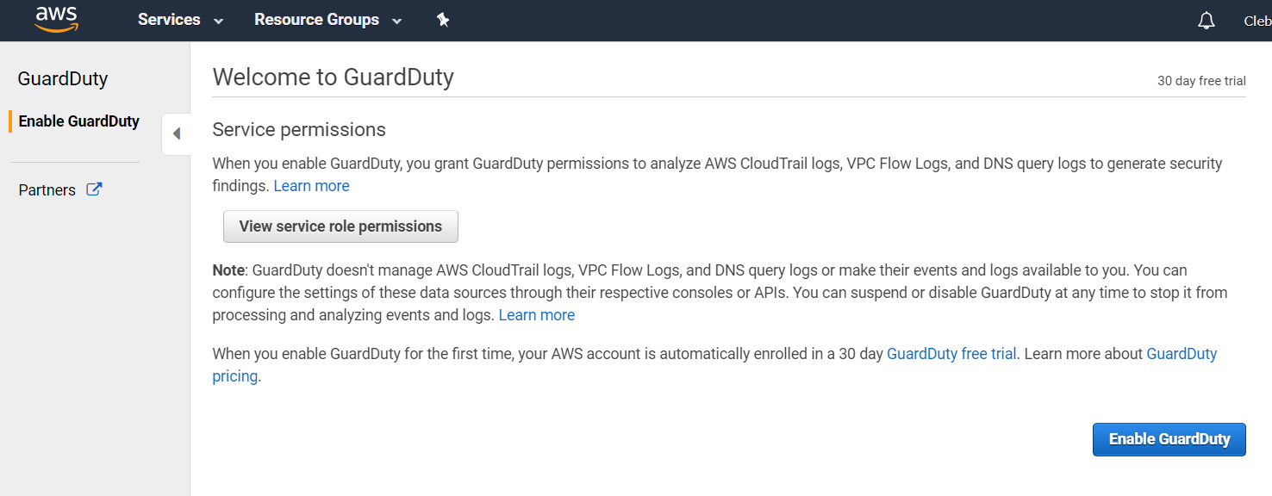


Enable Amazon GuardDuty
Notes:
After you confirm that you want to enable Amazon GuardDuty, follow these steps. First, log in to your AWS console and search for GuardDuty in the list of services. Next, select the button to enable GuardDuty. When you enable GuardDuty, you give it permission to set up the appropriate service-linked roles and to analyze your logs. A service-linked role is a unique type of IAM role that is linked directly to an AWS service, which is GuardDuty in this case. Service-linked roles are predefined by the service, and they include all the permissions that the service requires to call other AWS services on your behalf. The linked service—which, in this case, is GuardDuty—also defines how you create, modify, and delete a service-linked role.
When you enable GuardDuty, it immediately starts analyzing your VPC Flow Logs data. It consumes VPC Flow Log events directly from the VPC Flow Logs feature through an independent and duplicative stream of flow logs. This process does not affect any existing flow log configurations that you might have. GuardDuty does not manage your flow logs or make them accessible in your account. To manage the access and retention of your flow logs, you must configure the VPC Flow Logs feature.
There is no additional charge for Amazon GuardDuty access to flow logs. However, enabling flow logs for retention or use in your account is subject to existing pricing.

Slide 25
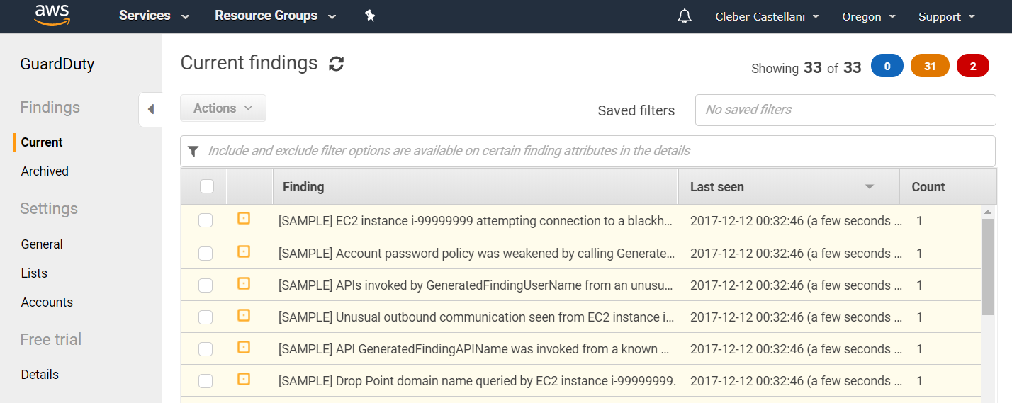
Findings
Notes:
After you enable GuardDuty, findings are displayed in the console. The slide shows an example of the kinds of findings that are available in the console. To access the findings, go to General Settings and select Generate Sample Findings.

Slide 26
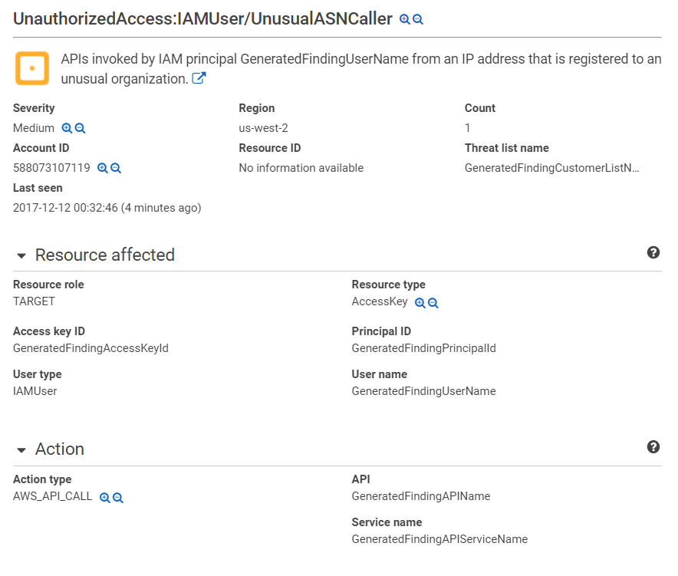
Findings
Notes:
To learn more about a specific finding, select the finding that you are interested in. In this example, the finding reports that there was a suspicious website that tried to make an API call, so it was flagged.

Slide 27
Securing Data in CloudFront
Notes:
Next, let’s discuss securing data in CloudFront.

Slide 28
CloudFront Custom SSL Support
By default, your content is delivered to viewers over HTTPS by using a CloudFront distribution domain name such as https://dxxxxx.cloudfront.net/image.jpg
Custom SSL certificate support features let you use your own domain name and your own SSL certificate.
Server Name Indication (SNI) Custom SSL.
Allows multiple domains to serve SSL traffic over the same IP address.
Dedicated IP Custom SSL.
To deliver content to browsers that do not support SNI.
Notes:
By default, your content is delivered to viewers over HTTPS by using a CloudFront distribution domain name.
CloudFront has custom Secure Sockets Layer—or SSL—support. You can create your own certificate that will have the CloudFront.net domain, or you can bring your own certificate if you have a specific domain name that you want to use.
Server Name Indication—or SNI—Custom SSL relies on the SNI extension of the Transport Layer Security protocol, which allows multiple domains to serve SSL traffic over the same IP address. Amazon CloudFront delivers your content from each edge location, and offers the same security as the Dedicated IP Custom SSL feature.
When you use SNI Custom SSL, some users might not be able to access your content if they use older browsers. Some older browsers do not support SNI, and these browsers will not be able to establish a connection with CloudFront to load the HTTPS version of your content. There is no separate pricing for this feature. You can use SNI Custom SSL with no upfront or monthly fees for certificate management. Instead, you pay normal CloudFront rates for data transfer and HTTPS requests.
In contrast, a Dedicated IP Custom SSL works for all clients. If you need to deliver content to browsers that don’t support SNI, you can use the Dedicated IP Custom SSL feature. For this feature, CloudFront allocates dedicated IP addresses to serve your SSL content at each CloudFront edge location.
To learn more about Dedicated IP Custom SSL certificate support, select the link.
http://aws.amazon.com/cloudfront/custom-ssl-domains/
When we approve your request , you can upload an SSL certificate and use the AWS Management Console to associate it with your CloudFront distributions. If you need to associate more than one custom SSL certificate with your CloudFront distribution, include details about your use case and the number of custom SSL certificates that you intend to use in the “Use Case and # of SSL Certs You Intend to Use” section of the form.

Slide 29
Use Alternate Domain Names with HTTPS
To use dedicated IP, request permission for your AWS account (not necessary for SNI).
Upload your SSL certificate to the IAM certificate store using AWS Certificate Manager (Preferred) or AWS CLI.
Update your distribution to include your domain names.
Specify which SSL certificate you want to use.
Specify dedicated IP address or SNI.
Add or update DNS records.
Notes:
By default, when you request permission to use an alternate domain name with HTTPS, we update your account so that you can associate two custom SSL certificates with your CloudFront distributions. Typically, you only use the second certificate temporarily, such as when you have more than one distribution and you need to rotate certificates. If you need to permanently associate two or more certificates with your distributions, indicate how many certificates you need, and describe your circumstances in your request.
You can upload your SSL certificate to the IAM certificate store by using the AWS Certificate Manager, or ACM. You can also use the AWS Command Line Interface, or AWS CLI.
ACM is the preferred tool for provisioning, managing, and deploying your server certificates. With ACM, you can request a certificate. You can also use ACM to deploy an existing ACM or external certificate to AWS resources. Certificates that are provided by ACM are free, and they automatically renew. You can use ACM to manage server certificates from the console or programmatically.
You can use IAM as a certificate manager only when you must support HTTPS connections in a Region that is not supported by ACM. IAM securely encrypts your private keys, and it stores the encrypted version in IAM SSL certificate storage. IAM supports deploying server certificates in all Regions, but you must obtain your certificate from an external provider for use with AWS. You cannot upload an ACM certificate to IAM.
When you use the IAM CLI to upload your SSL certificate to the IAM certificate store, you must use the same AWS account that you used to create your CloudFront distribution.
When you upload your certificate to IAM, the value of the -path parameter, or certificate path, must start with /cloudfront/. Examples of the -path parameter include /cloudfront/production/ or /cloudfront/test/. The path also must end with a /.
If you plan to use the CloudFront API to create or update your distribution, make sure that you note the alphanumeric string that the AWS CLI returns, such as AS1A2M3P4L5E67SIIXR3J. This string is the value that you will specify in the IAMCertificateId element. You do not need the IAM Amazon Resource Name—or ARN—which is also returned by the CLI.
You can update your distribution to include your domain names so that you can specify which SSL certificate you want to use, specify a dedicated IP address or SNI, and add or update DNS records.
After you associate your SSL certificate with your CloudFront distribution, do not delete the certificate from the IAM certificate store until you remove the certificate from all distributions, and until the status of the distributions has changed to Deployed.
To request permission, select the link.
https://aws.amazon.com/cloudfront/custom-ssl-domains/

Slide 30
Advanced SSL Features Support
High-security ciphers
Improve the security of HTTPS connections.
Perfect Forward Secrecy
Provides additional safeguards against eavesdropping of encrypted data through a unique random session key.
OCSP Stapling
Improves the time taken for individual SSL/TLS handshakes by moving the Online Certificate Status Protocol (OSCP) check.
Session Tickets
Helps speed up the time spent restarting or resuming an SSL/TLS session.
Notes:
Support for advanced SSL features include:
High security ciphers to improve the security of HTTPS connections. Amazon CloudFront edge servers and clients, such as browsers, automatically agree on a cipher as part of the SSL handshake process. The connections can now use ciphers with advanced features, such as Elliptic Curve signatures and key exchanges.
Perfect forward secrecy uses a unique random session key to provide additional safeguards against the eavesdropping of encrypted data. This feature prevents the decoding of captured data, even if the secret long-term key is compromised.
OCSP stapling improves the time taken for individual SSL handshakes. It moves the Online Certificate Status Protocol—or OSCP—check, which is a call that is used to obtain the revocation status of an SSL certificate, from the client to a periodic, secure check by the Amazon CloudFront servers. With OCSP stapling, the client no longer needs to handle certificate validation, which improves performance.
Session tickets help speed up the time that is spent restarting or resuming an SSL session. Amazon CloudFront encrypts SSL session information and stores it in a ticket. The client can use this ticket to resume a secure connection instead of repeating the SSL handshake process.

Slide 31
CloudFront New Origin Security Features
Enforce HTTPS-only connection between CloudFront and your origin webserver
Configure CloudFront to use HTTPS to connect to your origin server.
Support for TLSv1.1 and TLSv1.2.
Add or modify request headers forwarded from CloudFront to your origin.
Configure CloudFront to add custom headers or override the value of existing request headers when CloudFront forwards requests to your origin.
Notes:
Amazon has announced three new security features that help further protect communication between Amazon CloudFront and your origin server:
You can configure CloudFront to connect to your origin server by using HTTPS, regardless of whether the viewer uses HTTP or HTTPS to make the request.
You can use Transport Layer Security—or TLS—version 1.1 and TLS version 1.2, which were both added to the list of supported protocol versions that you can use for the HTTPS connections between CloudFront and your custom origin web server. In addition, you can choose the protocols that CloudFront uses to communicate with your origin server. For example, you can prevent CloudFront from communicating with your origin server through SSL version 3, which is less secure than TLS.
You can add or modify request headers that are forwarded from CloudFront to your origin server. You can configure CloudFront to add custom headers, or override the value of existing request headers, when CloudFront forwards requests to your origin server. You can use these headers to help validate that the requests that were made to your origin server were sent from CloudFront, which is a shared secret. You can also configure your origin server to only allow requests that contain the custom header values that you specify. This feature also helps you set up cross-origin request sharing—or CORS—for your CloudFront distribution. You can configure CloudFront to always add custom headers to your origin to accommodate viewers that don't automatically include those headers in requests. You can also disable varying on the origin header, which improves your cache hit ratio, and still forward the appropriate headers so that your origin server can respond with the CORS header.
For more information, go to the CloudFront documentation about requiring HTTPS for communication:
http://docs.aws.amazon.com/AmazonCloudFront/latest/DeveloperGuide/using-https-viewers-to-cloudfront.html

Slide 32
How to Make Content Private
Restrict access to objects in your Amazon S3 bucket.
Require that users use signed URLs.
Create CloudFront key pairs for your trusted signers.
Write the code that generates signed URLs.
Typically, you'll write an application that automatically generates signed URLs.
Alternatively, use a web interface to create signed URLs.
Add trusted signers to your distribution.
Once you add a trusted signer to your distribution, users must use signed URLs to access the corresponding content.
Use a canned policy to restrict access to a single object.
Use a custom policy to restrict access to one or more objects using pattern matching.
Notes:
To make content private, you can restrict access to objects in your Amazon S3 bucket.
You can also require that users use signed URLs. You can create CloudFront key pairs for your trusted signers, and write the code that generates signed URLs.
Typically, you will write an application that automatically generates signed URLs. Alternatively, you can use a web interface to create signed URLs.
You can add trusted signers to your distribution. After you add a trusted signer to your distribution, users must use signed URLs to access the corresponding content.
A signed URL includes additional information, such as an expiration date and time, which gives you more control over access to your content. This additional information appears in a policy statement that is based on either a canned policy or a custom policy:
Use a canned policy to restrict access to a single object.
Use a custom policy to restrict access to one or more objects by using pattern matching.
Select the links to learn more about each type of policy.
Canned policy: http://docs.aws.amazon.com/AmazonCloudFront/latest/DeveloperGuide/private-content-creating-signed-url-canned-policy.html
Custom policy: http://docs.aws.amazon.com/AmazonCloudFront/latest/DeveloperGuide/private-content-creating-signed-url-custom-policy.html

Slide 33
Origin Access Identity to Restrict Access
Restrict access to Amazon S3 content by creating an origin access identity (OAI), which is a special CloudFront user.
CloudFront origin access identity gets the objects from Amazon S3 on your users’ behalf.
Direct access to the objects through Amazon S3 URLs will be denied.
Procedure:
Create an origin access identity and add it to your distribution using the CloudFront console or the CloudFront API.
Change the permissions either on your Amazon S3 bucket or the objects in your bucket so that only the origin access identity has read permission.
Notes:
You can restrict access to Amazon S3 content by creating an origin access identity, or OAI, which is a special CloudFront user.
CloudFront origin access identity gets objects from Amazon S3 on behalf of your users. Direct access to the objects through Amazon S3 URLs will be denied.
To use this feature, you first create an origin access identity, and then add it to your distribution. You then change the permissions either on your Amazon S3 bucket or the objects in your bucket so that only the origin access identity has read permission.
You can create an origin access identity by using the CloudFront console or the CloudFront API.
To learn more about the CloudFront console and the CloudFront API, select the links.
CloudFront console: http://docs.aws.amazon.com/AmazonCloudFront/latest/DeveloperGuide/private-content-restricting-access-to-s3.html#private-content-creating-oai-console
CloudFront API: http://docs.aws.amazon.com/AmazonCloudFront/latest/DeveloperGuide/private-content-restricting-access-to-s3.html#private-content-creating-oai-api

Slide 34
Use IAM to Control API Access
Control a user’s API access to CloudFront with IAM policies.
Group policy example:
{
"Version": "2012-10-17",
"Statement":[{
"Effect":"Allow",
"Action":["cloudfront:*"],
"Resource":"*",
"Condition":{
"Bool":{
"aws:SecureTransport":"true"
}
}
}
]
}
Grant permission to access all CloudFront actions for the group this policy is attached to…
…with condition that actions require use of SSL/TLS
Notes:
Displayed is an example of an IAM policy that enforces SSL. It grants application permission to access all of CloudFront. However, it also requires secure transport, which means you must use SSL or TLS.
In an IAM policy, you can specify any and all API actions that CloudFront offers. The action name must be prefixed with the lowercase string cloudfront:. An example of an action name is: cloudfront:GetDistributionConfig
To learn more about AWS Authentication and Access Control, select the link.
http://docs.aws.amazon.com/AmazonCloudFront/latest/DeveloperGuide/UsingWithIAM.html

Slide 35
Encrypting Data
Notes:
Now, let’s discuss encrypting your data.

Slide 36










Encryption Primer
Key is used to encrypt data along with an encryption algorithm (e.g. AES).
Hardware or Software
Symmetric Data Key
Plaintext Data
Encrypted Data
?
Key is generated from either software or hardware.
Encrypted Data in Storage
?
Key Hierarchy
Symmetric Data Key
Master Key
Encrypted Data Key
You don’t want to store the key with the encrypted data!
Key encryption key
Notes:
Displayed is a basic review of encryption. First, you get your key, which is either hardware or software. This example uses a symmetric data key that will be used to encrypt plaintext data. This process results in encrypted data that can be stored in a database or in an Amazon S3 bucket.
When it’s time to decrypt the data and read it, you take the combination of the symmetric data key and the master key, which creates an encrypted data key. This process unlocks the encrypted document, and you can read the document as plaintext data.

Slide 37


AWS Key Management Service (KMS)
AWS KMS is a managed encryption service that enables you to easily encrypt your data.
Two-tiered key hierarchy using envelope encryption.
Data keys are unique.
AWS KMS master keys encrypt data keys.
AWS KMS master keys never leave the AWS KMS system.
Customer Master Keys
AWS KMS
Data Key 1
Data Key 2
Data Key 3
Data Key 4
Amazon S3 Object
Amazon EBS Volume
Amazon Redshift Cluster
Custom Application
Notes:
AWS Key Management Service, or AWS KMS, is a managed encryption service that enables you to easily encrypt your data. AWS Key Management System provides a highly available, two-tiered key hierarchy that uses envelope encryption. It is a storage, management, and auditing solution that you can use to encrypt your data across AWS services, and within your own applications.
Data keys are unique to your application, and there is a customer master key. If you use AWS KMS, we maintain the trusted root of authority on the key, which protects your customer key. It never leaves our location.
Because of how AWS KMS handles key security, if your data keys are compromised—for example, if someone gets a hold of your Amazon S3 data key—only your Amazon S3 bucket would face exposure. None of the other services would be impacted because we use separate data keys for each one of your services.
If you are a developer who needs to encrypt data in your applications, you can use the AWS software development kids, or SDKs, with AWS KMS support to use and protect encryption keys. If you are an IT administrator who wants to use a scalable key management infrastructure to support your developers and their growing number of applications, you can use AWS KMS to reduce your licensing costs and operational burden. If you are responsible for providing data security for regulatory or compliance purposes, you can use AWS KMS to verify that data is encrypted consistently across the applications where it is used and stored.
To learn more about AWS KMS, select the link.
https://aws.amazon.com/kms/

Slide 38
Data Keys
1
Request for data key
CMK
Application
Encrypted Data Key
Data Key
2
AWS KMS
Encrypted Data Key
Client Decryption
Client Encryption
Data Key
Encrypted Data
Data is encrypted using the data key
Data Store
Data Key
Encrypted Data
Encrypted Data Key
Plaintext Data
Plaintext Data
3
4
Application
Notes:
Displayed is an example of the AWS KMS customer master key, along with data keys. A customer master key, or CMK, is used to encrypt and decrypt data. CMKs are the fundamental resources that AWS KMS manages. CMKs can be either customer-managed keys or AWS-managed keys. They can be used inside of AWS KMS to encrypt or decrypt up to 4 KB of data directly. They can also be used to encrypt generated data keys, which are then used to encrypt or decrypt larger amounts of data outside of the service. CMKs can never leave AWS KMS unencrypted, but data keys can.
In this example, you have an application, and you have the AWS KMS system with your customer master key.
The first step is that the application requests the data key.
After it receives the key, it then sends both the encrypted data key and the data key to AWSK KSM so that AWK KMS can unlock the data. Each account for each service that is integrated with AWS KMS has one AWS-managed key. This key is referred to as the default key for the service under your account.
The next step is that the plaintext data is encrypted by using the data key, and it finally becomes encrypted data.
After the data is encrypted, both the encrypted data and the data key can be stored in either an Amazon EC2 instance, an Amazon EBS volume, or an Amazon S3 bucket.

Slide 39
Benefits of Using AWS KMS
Only data keys are available directly to the customer, and these are unique to each item encrypted.
If one was compromised, it would not allow decryption of other objects.
The risk of a compromised data key is limited.
The performance for encrypting large data sets is improved.
It is easier to manage a small number of master keys than millions of data keys.
Notes:
Let’s review some of the benefits of using AWS KMS.
The first benefit is that only data keys are available directly to the customer. AWS takes ownership of your customer master keys, which means that the customer master keys will not leave and will not get lost. Keys are unique to each encrypted item. You submit data to AWS KMS to be encrypted or decrypted under keys that you control. You set usage policies on these keys that determine which users can use them to encrypt and decrypt data. All requests to use these keys are logged in AWS CloudTrail, so you can know who used which key and when they used it.
The risk of a compromised data key is limited. If your data is compromised, it would not allow decryption of other objects.
Another benefit is that the performance for encrypting large data sets is improved, because it is easier to manage a small number of master keys than millions of data keys.
In AWS KMS, you can perform key management functions, such as:
• Creating keys with a unique alias and description.
• Defining which IAM users and roles can manage keys, and use keys to encrypt or decrypt data.
• Having AWS KMS automatically rotate your keys on an annual basis.
• Temporarily disabling keys so they cannot be used by anyone.
• Re-enabling disabled keys.
• And auditing the use of keys by inspecting logs in AWS CloudTrail.

Slide 40

Integration with AWS Services
AWS KMS is seamlessly integrated with most other AWS services.
Master key options
Use a default master key that is created for you automatically and usable only within the integrated service.
Or select a custom master key that you created.
Also integrated into the AWS SDK and provides a RESTful API.
Notes:
AWS KMS is seamlessly integrated with most other AWS services, including Amazon EBS, Amazon S3, Amazon RDS, Amazon Redshift, Amazon Elastic Transcoder, Amazon Workmail, and Amazon EMR. This integration means you can easily use AWS KMS master keys to encrypt the data you store with these services. You can use a default master key that is created for you automatically and is usable only within the integrated service. You can also use a custom master key that you either created in KMS, or that you imported from your own key management infrastructure and have permission to use.
AWS KMS is also integrated into the AWS SDK and the AWS CLI, and it provides a RESTful API. When you use these interfaces to encrypt or decrypt data, encryption or decryption operations will happen automatically--you select which AWS KMS master key to use. In addition, AWS KMS is integrated with AWS CloudFormation so that you can quickly create keys in AWS KMS by using the CloudFormation template for AWS KMS.
To learn more about integration on AWS KMS, select the link.
http://aws.amazon.com/kms/details/#integration

Slide 41

Amazon EBS Volume Encryption Using AWS KMS
Amazon EBS Volume
AWS KMS Interface
Encrypted volume key stored with volume metadata
1
Generate Data Key (CMK)
Requests a volume key
Uses volume key to decrypt or encrypt all data from or to the volume
Receives encrypted volume key
2
4
3
Decrypt
Requests to decrypt the encrypted volume key
Amazon EC2 Host
Notes:
This slide shows an example of Amazon EBS that’s requesting a volume key. The request goes to AWS KMS, and receives the encrypted volume key. The Amazon EC2 host sends a request to decrypt the encrypted volume key. Finally, the Amazon EC2 instance can then use that volume key to decrypt or encrypt all the data to and from the Amazon EBS volume.
To learn more, select the link:
http://nvlpubs.nist.gov/nistpubs/Legacy/SP/nistspecialpublication800-38e.pdf

Slide 42

AWS CloudHSM
Protects your cryptographic keys using a dedicated, tamper-resistant hardware security module (HSM).
Helps you comply with strict cryptographic key management requirements.
AWS provides Luna appliances, designed to meet FIPS 140-2 and Common Criteria EAL4+ standards.
Notes:
Now, let’s review AWS CloudHSM, or the Cloud Hardware Security Module. The AWS CloudHSM service helps you meet corporate, contractual, and regulatory compliance requirements for data security by using dedicated hardware security module appliances within the AWS Cloud. A hardware security module is a hardware appliance that protects cryptographic keys by using a dedicated tamper-resistant hardware device.
The CloudHSM appliance helps you comply with strict cryptographic key management requirements. AWS and AWS Partner Network—or APN—Partners offer a variety of solutions for protecting sensitive data within the AWS platform. However, additional protection might be necessary for some applications and data that are subject to strict contractual or regulatory requirements for managing cryptographic keys. AWS CloudHSM helps you comply with strict key management requirements within the AWS Cloud without sacrificing application performance.
As part of the service, AWS currently provides Luna SA 7000 HSM appliances from SafeNet, Inc. These appliances are designed to meet Federal Information Processing Standard 140-2 and Common Criteria EAL4+ standards.
To learn more about appliances, select each link.
Luna SA HSM appliances: http://www.safenet-inc.com/data-encryption/hardware-security-modules-hsms/luna-hsms-key-management/luna-sa-network-hsm/
FIPS 140-2: https://en.wikipedia.org/wiki/FIPS_140-2
Common Criteria EAL4+: https://en.wikipedia.org/wiki/Common_Criteria

Slide 43
AWS CloudHSM Features
Pay as you go with no upfront costs.
Pay an hourly fee for each HSM you launch until you terminate the HSM.
Is Scalable.
Generate and use encryption keys on highly secure HSMs.
Use an open HSM built on industry standards.
HSMs are inside your Amazon VPC.
Automatic patching, backup, and high availability.
Protect your keys with strong authentication.
Notes:
Let’s review some features and benefits of CloudHSM:
• CloudHSM pricing is based on use, so you do not have any upfront costs. You will be charged an hourly fee for each hour—or partial hour—that a CloudHSM appliance is provisioned to a CloudHSM Cluster until you terminate it.
• It is scalable.
• You can generate and use encryption keys on highly secure HSMs.
• You can use an open HSM built on industry standards.
• CloudHSM appliances are inside your Amazon VPC.
• CloudHSM offers automatic patching, backup, and high availability.
• You can protect your keys with strong authentication.

Slide 44
AWS CloudHSM vs. AWS KMS
AWS CloudHSM | AWS KMS
Single-tenant HSM | Multi-tenant AWS service
Customer-managed durability and availability | Highly available and durable key storage and management
Customer managed root of trust | AWS managed root of trust
Broad third-party app support | Broad support for AWS services
Symmetric and asymmetric options | Symmetric encryption only
Notes:
Displayed is a comparison of AWS CloudHSM and AWS KMS.
One important note is that CloudHSM is a single tenant service, while AWS KMS is a multi-tenant service. Some companies might not be comfortable with using AWS KMS from a compliance perspective using because it is multi-tenant.
With AWS CloudHSM, you have total control over your keys and the application software that uses them. However, with AWS KMS, we securely manage the keys.
Symmetric and asymmetric options are available with AWS CloudHSM, but AWS KMS offers symmetric encryption only.

Slide 45
Encrypting Source and Output Data at Rest in Amazon S3
Notes:
Now, let’s discuss encrypting source and output data at rest in Amazon S3.

Slide 46
Data at Rest in Amazon S3
Data stored in Amazon S3 is private by default, requires AWS credentials for access.
Access to Amazon S3 can be over HTTP or HTTPS.
Amazon S3 logging allows auditing of access to all objects.
Amazon S3 supports access control lists and policies for every bucket, prefix (directory/folder), and object.
Notes:
Data that you store in Amazon S3 is private by default, and it requires AWS credentials for access.
You can access Amazon S3 over HTTP or HTTPS.
Amazon S3 logging allows you to audit access to all objects.
Server-side encryption is about data encryption at rest—that is, Amazon S3 encrypts your data as it writes it to disks in its data centers, and it decrypts your data for you when you access it. If you authenticate your request and have access permissions, there is no difference in the way you access encrypted or unencrypted objects. Amazon S3 manages encryption and decryption for you. For example, if you share your objects by using a pre-signed URL, the pre-signed URL works the same way for both encrypted and unencrypted objects.
In client-side encryption, you manage the encryption and decryption of your data, the encryption keys, and any related tools. Server-side encryption is an alternative to client-side encryption. In this model, Amazon S3 manages the encryption of your data, which frees you from the tasks of managing encryption and encryption keys.
Server-side encryption with Amazon S3-managed keys—or SSE-S3—employs strong multi-factor encryption. With SSE-S3, Amazon S3 encrypts each object with a unique key. As an additional safeguard, it encrypts the key itself with a master key that it regularly rotates. SSE-S3 uses one of the strongest block ciphers available—256bit Advanced Encryption Standard, or AES-256—to encrypt your data.
You can encrypt data by using any encryption method you want, and then upload the encrypted data using the Amazon S3 APIs. The most common application languages include cryptographic libraries that allow you to perform encryption in your applications. Two commonly available open source tools are Bouncy Castle and OpenSSL.
It supports access control lists and policies for every bucket, prefix—such as a directory or folder—and object.
After you encrypt an object and safely store the key in your KMI, the encrypted object can be uploaded to Amazon S3 directly with a PUT request. To decrypt this data, you issue the GET request in the Amazon S3 API, and then pass the encrypted data to your local application for decryption.
AWS provides an alternative to these open source encryption tools with the Amazon S3 encryption client, which is an open source set of APIs that are embedded into the AWS SDKs. This client allows you to supply a key from your KMI that can be used to encrypt or decrypt your data as part of the API call to Amazon S3. The Amazon S3 encryption client is integrated into the AWS SDKs for Java, Ruby, and .NET. It provides a transparent drop-in replacement for any cryptographic code that you might have used previously with your application that interacts with Amazon S3. Although Amazon provides the encryption method, you control the security of your data because you control the keys for that engine to use. If you use the Amazon S3 encryption client on-premises, we never have access to your keys or unencrypted data. If you use the client in an application that runs in Amazon EC2, a best practice is to pass keys to the client by using secure transport—such as SSL or SSH—from your KMI to help ensure confidentiality.
To learn more, select the link to view the AWS whitepaper on securing data at rest with encryption. https://aws.amazon.com/whitepapers/

Slide 47
Data at Rest with Amazon S3
Amazon S3 provides server-side encryption (AES-256) using AWS-maintained keys or customer provided keys.
AWS encryption keys are further encrypted with a rotating key.
Can also encrypt data before storage in Amazon S3 (client-side encryption).
Three options:
Amazon S3-Managed Keys (SSE-S3)
KMS-Managed Keys (SSE-KMS)
Customer-Provided Keys (SSE-C)
Notes:
Amazon S3 provides server-side encryption by using AES-256. Server-side encryption can use AWS-maintained keys or customer-provided keys.
AWS encryption keys are further encrypted with a rotating key.
For client-side encryption, Amazon S3 also allows you to encrypt data before you store it in Amazon S3.
You have three mutually exclusive options, depending on how you choose to manage encryption keys:
• When you want to encrypt each object with a unique key that employs strong multi-factor encryption, use SSE-S3 with managed keys.
• Server-side encryption with AWS KMS-managed keys (SSE-KMS) provides a service that is similar to SSE-S3. It includes some additional benefits, and it also includes some additional charges for using this service.
• Use server-side encryption with customer-provided keys (SSE-C) when you want to manage the encryption keys. Amazon S3 manages the encryption as it writes to disks, and it also manages the decryption when you access your objects.
For more information about Amazon S3 server-side encryption, select the link.
https://docs.aws.amazon.com/AmazonS3/latest/dev/serv-side-encryption.html

Slide 48





AWS Server-Side Encryption
Your applications in your data center
Your applications on Amazon EC2
With Amazon Glacier, data is encrypted by default.
HTTPS
With Amazon RDS for Oracle and MS-SQL, use a feature specific to those databases (Transparent Data Encryption).
AWS Storage Services
With Amazon S3 and encryption is an optional step.
Amazon S3
Amazon Glacier
RDS for Oracle
RDS for MS-SQL
Notes:
Displayed is an example of how server-side encryption works in AWS. In this diagram, you transmit data to Amazon S3 either from your on-premises data center or from an Amazon EC2 instance, if you are using HTTPS. You can choose to turn on encryption when you upload your data to the service.
Take note that in Amazon S3, encryption is not enabled by default.
With Amazon Glacier, all data is encrypted by default.
Amazon RDS for Oracle and Microsoft SQL uses a feature that is specific to those database packages, which is called Transparent Data Encryption, or TDE. TDE protects your data by using keys that are created in the database application with keys that are created by AWS.

Slide 49
Encrypting Amazon RDS Connections
You are responsible for encryption of your data in-transit.
You can use SSL/TLS to encrypt connections between applications and DB Instances.
You can onfigure your DB instance to accept only encrypted connections.
You can encrypt of data connections helps meet compliance standards.
Notes:
Keep in mind that when you connect to your relational database, you need to make sure the data is both encrypted on the server side in storage, and in transit.
You can use SSL/TLS to encrypt connections between your application and your database—or DB—instances. For MySQL and SQL Server, Amazon RDS creates an SSL certificate, and it installs the certificate on the DB instance when the instance is provisioned. When you want to encrypt connections in MySQL, launch the MySQL client by using the --ssl_ca parameter to reference the public key. For SQL Server, download the public key, and import the certificate into your Windows operating system. Oracle RDS uses Oracle native network encryption with a DB instance. You add the native network encryption option to an option group, and associate that option group with the DB instance. After an encrypted connection is established, data that is transferred between the DB instance and your application will be encrypted during the transfer. You can also require your DB instance to only accept encrypted connections.
The encryption of data connections helps meet compliance standards.
SSL and TLS support within Amazon RDS is used to encrypt the connection between your application and your DB instance. You should not rely on SSL and TLS for authenticating the DB instance itself.
While SSL and TLS offers security benefits, be aware that the encryption is a compute-intensive operation, and it will increase the latency of your database connection.

Slide 50
Encrypting Amazon RDS Resources
Use encryption option to encrypt data at-rest.
Underlying storage for the instance, its backups, logs, Read Replicas, and snapshots.
Uses AES-256 encryption algorithm.
Encrypt data at rest to help meet compliance standards.
Use automatic handling for authentication and decryption.
Use TDE for Oracle and SQL Server DB instances.
Use AWS Key Management Service to manage keys.
Notes:
You can encrypt your Amazon RDS instances and snapshots at rest by enabling the encryption option for your Amazon RDS DB instance. Data that is encrypted at rest includes the underlying storage for a DB instance, its automated backups, Read Replicas, and snapshots.
Amazon RDS-encrypted instances use the industry standard AES-256 encryption algorithm to encrypt your data on the server that hosts your Amazon RDS instance.
When your data is encrypted, Amazon RDS handles authenticating access and decrypting your data transparently, with a minimal impact on performance. You don't need to modify your database client applications to use encryption.
Amazon RDS-encrypted instances provide an additional layer of data protection by securing your data from unauthorized access to the underlying storage. You can use Amazon RDS encryption to increase data protection of your applications and to fulfill compliance requirements for data-at-rest encryption.
Amazon RDS-encrypted instances are currently available for MySQL, PostgreSQL, Oracle, and SQL Server DB instances.
Amazon RDS also supports encrypting an Oracle or SQL Server DB instance with Transparent Data Encryption, or TDE. TDE can be used in conjunction with encryption at rest, although using TDE and encryption at rest simultaneously might slightly affect the performance of your database. You must manage different keys for each encryption method. After you have created an encrypted DB instance, you cannot change the encryption key for that instance. Therefore, be sure to determine your encryption key requirements before you create your encrypted DB instance.
You can use AWS KMS to manage the keys that you use for encrypting and decrypting your Amazon RDS resources. AWS KMS combines secure, highly available hardware and software to provide a key management system that is scaled for the cloud. By using AWS KMS, you can create encryption keys and define the policies that control how these keys can be used. AWS KMS supports AWS CloudTrail, so you can audit key usage to verify that keys are being used appropriately.
All logs, backups, and snapshots for an Amazon RDS-encrypted instance are encrypted. A Read Replica of an Amazon RDS-encrypted instance is also encrypted by using the same key as the master instance.

Slide 51
Authentication
Notes:
Now, let’s review best practices for authentication.

Slide 52
AWS Directory Service
Managed service to:
Run Microsoft AD as a managed service within AWS Directory Service.
Connect your AWS resources with an existing on-premises Microsoft Active Directory (AD Connector).
Set up a new, stand-alone directory in the AWS Cloud (Simple AD).
Allows use of existing corporate credentials for:
Accessing AWS services (e.g. Amazon WorkSpaces, and Amazon WorkDocs).
Accessing the AWS Management Console through IAM Roles.
Notes:
AWS Directory Service is a managed service that you can use to run Microsoft Active Directory within AWS Directory Service. It allows you to connect your AWS resources in an existing on-premises Microsoft Active Directory (also known as AD Connector).
You can also set up a new, stand-alone directory in the AWS Cloud. Simple AD offers this solution.
You can use IAM roles to allow the use of existing corporate credentials for accessing AWS services—such as Amazon WorkSpaces and Amazon WorkDocs—and the AWS Management Console.
Select the link to learn more about the AWS Directory Service. https://aws.amazon.com/directoryservice/

Slide 53

AWS Directory Service: Options
Run Microsoft AD as a managed service within AWS Directory Service:
Powered by Windows Server 2012 R2.
Created as a highly available pair of domain controllers connected to your VPC.
Use AD Connector:
Connect to your on-premises Active Directory via VPC VPN connection or AWS Direct Connect.
Users access AWS applications with existing credentials.
Integrate with existing RADIUS-based MFA solutions.
Use Simple AD:
Launch managed stand-alone directories powered by Samba 4 Active Directory Compatible Server.
Supports common AD features.
Provides audit trails and event logs.
Notes:
Let’s review a few options when you run Microsoft Active Directory as a managed service within AWS Directory Service.
It is powered by Windows Server 2012 Revision 2, and is created as a highly available pair of domain controllers that are connected to your VPC.
If you want to use AD Connector, connect to your on-premises Active Directory installation via a VPC VPN connection or through AWS Direct Connect.
Users can access AWS applications with existing credentials, and you can integrate with existing RADIUS-based multi-actor authentication solutions.
Simple AD provides launch-managed, stand-alone directories that are powered by Samba 4 Active Directory Compatible Server.
Simple AD supports common Active Directory features. It provides audit trails and event logs so that you can track how your directory is used, including which users logged in, when these users logged in, and any accounts that have been locked because of failed login attempts. You can use standard Microsoft Windows event log tools to review directory audit and event logs. By default, Simple AD also provides daily automated snapshots to enable point-in-time recovery.

Slide 54
AWS Security Token Service (STS)
Lightweight web service that enables you to request temporary, limited-privilege credentials for IAM users or for users that you authenticate (federated users).
Allow trusted entity to assume a role by calling the AssumeRole APIs of STS.
(STS) has a default endpoint that maps to the US East (N. Virginia) region.
Supports AWS CloudTrail.
Notes:
AWS Security Token Service—or AWS STS—is a lightweight web service that enables you to request temporary, limited-privilege credentials for IAM users, or for users that you authenticate, such as federated users.
It allows a trusted entity to assume a role by calling the AssumeRole API operation of the security token service. The AssumeRole operation returns a set of temporary security credentials that consist of an access key ID, a secret access key, and a security token. You can use these temporary credentials to access AWS resources that you might not normally have access to. Typically, you use the AssumeRole operation for cross-account access or federation.
Keep in mind that AWS STS has a default endpoint of https://sts.amazonaws.com that maps to the US East Region, which is in Northern Virginia. Additional Regions are available and activated by default.
If you are trying to authenticate users in Australia, this will introduce additional latency to the authentication process.
AWS STS supports AWS CloudTrail, which is a service that records AWS calls for your AWS account and delivers log files to an Amazon S3 bucket. By using information collected by AWS CloudTrail, you can determine which requests were successfully made to AWS STS, who made the request, when it was made, and so on.
Select the link to learn more about the AWS Token Security Service. https://docs.aws.amazon.com/STS/latest/APIReference/Welcome.html

Slide 55
Federated Users
Authenticate users to their own identity store:
You write an “identity broker application.”
Users authenticate to your identity broker.
Your identity broker provisions temporary credentials via AWS STS.
Single sign-On (SSO): Temporary credentials can be used to sign user directly into the AWS Management Console.
Notes:
Federated users authenticate users to their own identity store.
First, you write an identity broker application.
Your users will then authenticate to your identity broker.
Next, your identity broker provisions temporary credentials via AWS STS.
This process allows you to use single sign-on, or SSO. Temporary credentials can be used to sign users directly into the AWS Management Console.

Slide 56





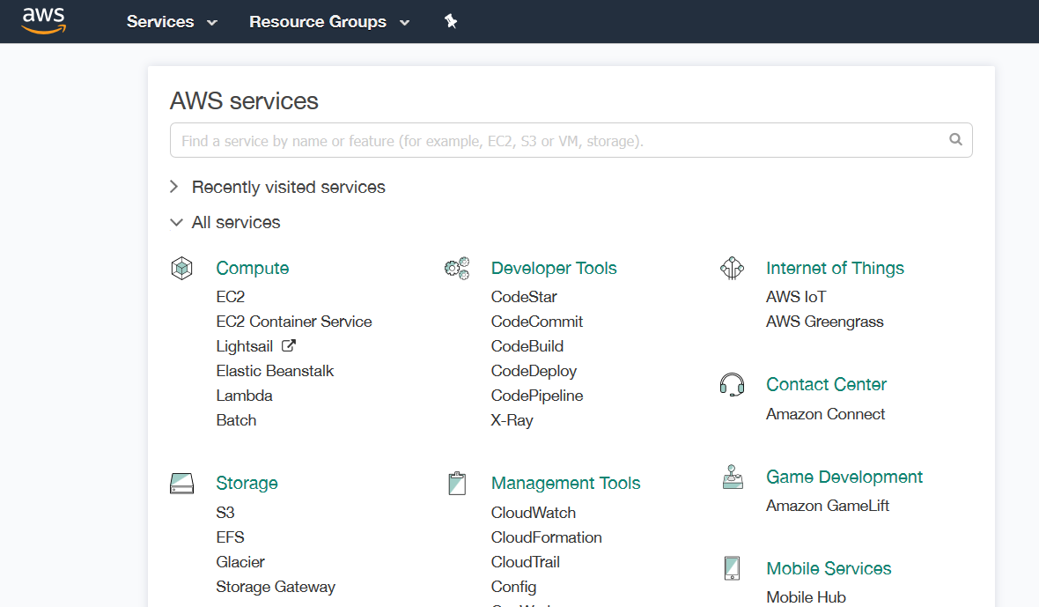


Use Case: AWS STS Identity Broker
AWS Cloud (Relying Provider)
Customer (Identity Provider)
Access AWS APIs
User Application
APP
4
AWS Services
1
Redirect to Console
User accesses broker
AWS Console
3
Identity Broker
Get Temporary
Security Credentials
2
AWS STS
Authenticate user
Corporate Identity Store
Notes:
Let’s review a use case.
In step one, users try to access AWS services from their local machine. They first go to the identity broker. From the identity broker, they are authenticated within their corporate identity store. After authentication, the identity broker reaches back to AWS STS to gain a token. After the identity broker has a token, the end user is redirected to the AWS console or to one of the APIs.
Select the link to learn more about the identity federation sample application for Active Directory use case.
http://aws.amazon.com/code/1288653099190193

Slide 57
SSO Federation Using SAML
AWS supports identity federation with SAML 2.0 (Security Assertion Markup Language).
Benefits:
Open standards.
Quicker to implement federation.
Use existing identity management software to manage access to AWS resources.
No coding required.
Notes:
AWS supports identity federation, which makes it easier to manage users by maintaining their identities in a single place. Identity federation includes support for the Security Assertion Markup Language—or SAML—2.0, which is an open standard that is used by many identity providers. You can use this feature to implement federation more quickly because it enables federated SSO. With federated SSO, users can sign in to the AWS Management Console or make programmatic calls to AWS APIs.
Identity federation uses existing identity management software to manage access to AWS resources. There are many use cases that illustrate how identity federation makes user administration easier. For instance, if a user leaves your company, you can simply delete the user’s corporate identity, which then also revokes access to AWS. End users also benefit because they only need to remember one user name and password. You can use SAML to make configuring federation with AWS straightforward, because system administrators can set it up using identity provider software instead of writing code.

Slide 58
SSO Federation Using SAML
AWS Management Console SSO:
IdP-initiated web SSO via SAML 2.0 using the HTTP-POST binding (web SSO profile).
New sign-in URL that greatly simplifies SSO:
https://signin.aws.amazon.com/saml<SAML_AuthN_response
API federation using new assumeRoleWithSAML operation.
Notes:
In order to use single sign-on for the AWS Management Console, your identity provider must initiate a web single sign-on session via SAML 2.0 by using the HTTP-POST binding.
A new sign-on URL greatly simplifies this process. In this case, the SAML authentication response and the API federation uses a new assumeRoleWithSAML operation within the code.

Slide 59
SSO Federation Using SAML
Enterprise (Identity Provider)
AWS (Service Provider)
Browser interface
Post the SAML assertion to sign-in
4
AWS Sign-in
1
User logs in to Portal
Identity Store
3
5
Receive response
(SAML assertion)
Redirected to AWS Management Console
2
User authenticated
Portal
Corporate Data Center
Notes:
Displayed is a diagram of how SSO federation works within SAML.
• For example, a user in your organization browses to an internal portal in your network. The portal also functions as the identity provider (IdP) that handles the SAML trust between your organization and AWS.
• The identity provider authenticates the user’s identity against the ID Store.
• After the client is authenticated, the client receives a SAML assertion in the form of authentication response from the IdP.
• It can then post the SAML assertion to the new AWS sign-in portal. Behind the scenes, sign-in uses the AssumeRoleWithSAML API operation to request temporary security credentials and construct a sign-in URL.
• Finally, the user’s browser receives the sign-in URL and is automatically redirected to the AWS Management Console.
From the user’s perspective, the process happens transparently. The user starts at your organization’s internal portal and ends up at the AWS Management Console without ever having to supply any AWS credentials.

Slide 60
Web Identity Federation
Use STS API, AssumeRoleWithWebIdentity
Lets you request temporary security credentials to access AWS resources.
Supported web identity providers:
Amazon
Google
Facebook
A mobile app can be developed without server-side code and without distributing long-term credentials with the mobile app.
Notes:
You can also use web identity federation when you use secure token service API with the AssumeRoleWithWebIdentity operation. This API operation lets you request temporary security credentials so that you can access AWS resources.
Supported web identity providers include Amazon, Google and Facebook.
Web identity federation is great for mobile apps where you don’t want to use server-side code, and you don’t want to distribute long term credentials.
To configure your application with federated credentials using trusted identity providers, you’d:
• Register an application with the identity provider.
• Create an IAM role for the identity provider.
• Set up permissions for the IAM role.
• Use the identity provider’s SDK to get an access to a token after logging in.
• And use the AWS SDK for JavaScript to get temporary credentials to your application.
For more information on Web Identity Federations, select the link.
https://aws.amazon.com/identity/federation/

Slide 61



Use Case: Web Identity Federation
1
Authentication
Access AWS Services
3
2
2
Authorization
AWS Services
Web Identity Provider
Web Identity
Federation
AWS STS
Notes:
Displayed is a use case for web identity federation.
First, the user logs in from a mobile phone. In this case, the login request then goes to Amazon to authenticate the user ID. After the user is authenticated, it receives the authorization from the Web Identity Federation to return a token. With that token, the user can now to log in to the AWS services they can access. By default, the credentials can be used for one hour.
If the role’s access policy uses variables that reference the application ID and the user ID, the temporary security credentials are scoped to that end user, and will prevent him or her from accessing objects owned by other users.

Slide 62
Exercise: Improve This Architecture
Notes:
Now, you will complete an exercise on how to improve an architecture.

Slide 63
Security
GoGreen has purchased a small company that was running a hybrid cloud architecture.
As their cloud expert, you were asked to review their design and determine how to improve the application in accordance with the Well-Architected framework.
Review the sample diagram and ask questions to identify where improvements can be made to the security of the system.
Recommend security enhancements in accordance with the Well-Architected Security pillar.
Notes:
In this scenario, GoGreen purchased a small company that was running a hybrid cloud architecture.
As their cloud expert, you were asked to review their design and determine how to improve the application in accordance with the Well-Architected Framework.
Next, you will review a sample diagram and ask questions to identify where improvements can be made to the security of the system.
You should consider the recommended security enhancements that you would make in accordance with the Security pillar of the Well-Architected Framework.

Slide 64





GoGreen
Customer Network
Public Subnet
Users
Remote Servers
RDS Master
IAM
Web Tier
Availability Zone 1
Amazon CloudWatch
Public Subnet
ELB
Internet gateway
Amazon S3
RDS Standby
Web Tier
Amazon Glacier
Availability Zone 2
Notes:
Take some time to review this sample diagram and ask questions that will help you identify where improvements can be made to the security of the system.
You should consider the recommended security enhancements that you would make in accordance with the Security pillar of the Well-Architected Framework.

Slide 65
GoGreen
Customer Network
Users
Remote Servers
RDS Master
IAM
Private Subnet
Web Tier
Public Subnet
Availability Zone 1
ELB
Amazon CloudWatch
Intenet
gateway
Amazon S3
RDS Standby
Private Subnet
Web Tier
Public Subnet
Amazon Glacier
Availability Zone 2
CloudTrail
Notes:
A few items to consider regarding security include:
• Moving to a private subnet.
• Implementing AWS Direct Connect instead of using internet routing.
• Verify the principles of least privilege on users.
• Ensure separation of duties through IAM.
• Ensure that Amazon CloudWatch has monitors for utilization, abnormal traffic, and AWS CloudTrail Logs.
• Enable AWS CloudTrail.
• Verify access control list policies and bucket policies for Amazon S3.
• Verify Amazon S3-SSE usage.
• Ensure users do not have delete privileges for Amazon Glacier.
• Consider using security groups for the web and Amazon RDS.
• And ensure that SSH requests come from only the administrator IP address.

Slide 66
Additional Resources
Documentation
AWS Security Center
AWS Compliance
AWS Security Blog
Whitepapers
AWS Security Overview
AWS Security Best Practices
AWS Risk and Compliance
Videos
Security of the AWS Cloud
Shared Responsibility Overview
Notes:
Displayed is a list of additional resources you can refer to. Select each link to learn more.

Slide 67
Security Pillar Questions
Notes:
Before we finalize this module, let’s review some questions and best practices regarding the Security pillar.

Slide 68

Security Question #1
How are you encrypting and protecting your data at rest?
Best practices
Use AWS service-specific controls, such as:
Amazon S3 SSE
Amazon EBS Encrypted Volumes
Amazon RDS Transparent Data Encryption (TDE)
Use client-side techniques, such as:
SDK-supported
OS-supported
Windows BitLocker
dm-crypt
Use a solution from the AWS Marketplace or APN Partner
Notes:
How are you encrypting and protecting your data at rest?
Take a moment to review some best practices.

Slide 69
Security Question #2
How are you encrypting and protecting your data in transit?
Best practices
SSL/TLS enabled AWS APIs.
SSL/TLS or equivalent is used for communication.
VPN based solution.
Private connectivity (AWS Direct Connect).
AWS Marketplace solution.
Notes:
How are you encrypting and protecting your data in transit?
Take a moment to review some best practices.

Slide 70
Security Question #3
How are you protecting access to and use of the AWS root account credentials?
Best practices
Only use AWS root account credentials for minimal required activities.
Associate an MFA hardware device with the AWS root account.
Use an AWS Marketplace solution.
Notes:
How do you protect access to the AWS root account credentials, and how they are used?
Take a moment to review some best practices.

Slide 71
Security Question #4
How are you defining roles and responsibilities of system users to control human access to the AWS Management Console and API?
Best practices
IAM users and groups
SAML integration
Web Identity Federation
AWS Security Token Service (STS)
IAM roles for cross-account access
AWS Marketplace solution
Define and enforce employee life-cycle policies
Clearly define users, groups, and roles.
Grants only the minimum privileges needed to accomplish business requirements.
Notes:
How do you define the roles and responsibilities of system users so that you can control human access to the AWS Management Console and the API?
Take a moment to review some best practices.

Slide 72
Security Question #5
How are you limiting automated access to AWS resources? (e.g. applications, scripts, and third-party tools or services)
Anti-pattern
Best practices
Hard-code the credential into scripts and source code
IAM roles for Amazon EC2
IAM user credential
SAML Integration
AWS Security Token Services (STS)
OS-specific controls for EC2 instances
AWS Marketplace solutions
Notes:
How are you limiting automated access to AWS resources, such as applications, scripts, and third-party tools or services?
Take a moment to review the anti-pattern and some best practices.

Slide 73
Security Question #6
How are you managing keys and credentials?
Anti-pattern
Best practices
Hard-code secret keys and credentials into scripts and source code
Use:
An appropriate key and credential rotation policy
AWS CloudHSM
AWS server-side techniques with AWS managed keys
AWS Marketplace solutions
Notes:
How are you managing keys and credentials?
Take a moment to review the anti-pattern and some best practices.

Slide 74
Security Question #7
How are you enforcing network and host-level boundary protection?
Best practices
Enforce role-based access using security groups with minimal authorizations.
Run the system in one or more VPCs.
Trusted VPC access is via a private mechanism, such as
Virtual Private Network (VPN)
IPsec tunnel
AWS Direct Connect
AWS Marketplace solution
Define and enforce employee life-cycle policies
Clearly define users, groups, and roles.
Grants only the minimum privileges needed to accomplish business requirements.
Notes:
How are you enforcing network and host-level boundary protection?
Take a moment to review some best practices.

Slide 75
Security Question #8
How are you enforcing AWS service level protection?
Best practices
Configure credentials with least privilege.
Have a separation of duties.
Audit permissions periodically.
Define and use service-specific requirements.
Define resource requirements for sensitive API calls, such as requiring:
MFA authentication
Encryption
Use an AWS Marketplace solution
Notes:
How are you enforcing AWS service-level protection?
Take a moment to review some best practices.

Slide 76
Security Question #9
How are you protecting the integrity of the operating system on your Amazon EC2 instances?
Best practices
Use controls for Amazon EC2 instances, including:
File integrity
Host-based intrusion detection
Use a solution from:
The AWS Marketplace
An APN Partner
Use custom Amazon Machine Images (AMIs) or configuration management tools (i.e., Puppet or Chef) that are secured by default.
Notes:
How are you protecting the integrity of the operating system on your Amazon EC2 instances?
Take a moment to review some best practices.

Slide 77
Security Question #10
How are you capturing and analyzing AWS logs?
Best practices
Capture logs using:
AWS CloudTrail
Amazon CloudWatch logs
Elastic Load Balancing (ELB) logs
Amazon Virtual Private Cloud (VPC) Flow Logs
Amazon S3 bucket logs
Other AWS service-specific log sources
Operating system or third-party application logs
Solutions from the AWS Marketplace
Notes:
How are you capturing and analyzing AWS logs?
Take a moment to review some best practices.

Slide 78

In Review
Identified how to protect information, systems, and assets across your architecture.
Discovered ways on how to prevent common security exploits.
Considered security pillar questions with best practices.
To finish this module:
Complete:
Knowledge Assessment
Notes:
In review, we:
Identified how to protect information, systems, and assets across your architecture.
Discovered ways on how to prevent common security exploits.
And considered security pillar questions with best practices.
To finish this module, please complete the corresponding knowledge assessment.
78

Slide 79

Module 10 Lab: Introduction to CloudFront
~ 20 minutes
Notes:
Now, it’s time for a lab where you will use AWS CloudFront. This lab will take approximately 20 minutes.

Slide 80
Lab Scenario
In this lab, you will:
Store a publicly accessible image file in an Amazon S3 bucket
Create an Amazon CloudFront Web Distribution
Create a link to your object
Delete your Amazon S3 bucket
Notes:
By the end of this lab, you will be able to:
Create a new Amazon CloudFront distribution.
Use your Amazon CloudFront distribution to serve an image file.
Delete your Amazon CloudFront distribution when it is no longer needed.

Slide 81
Up Next: Module 11: Well-Architected Pillar 3: Reliability
Notes:
Next, you proceed to Module 11: Well-Architected Pillar 3-Reliability.

Slide 82
Thanks for participating!
© 2018 Amazon Web Services, Inc. or its affiliates. All rights reserved. This work may not be reproduced or redistributed, in whole or in part, without prior written permission from Amazon Web Services, Inc. Commercial copying, lending, or selling is prohibited. Corrections or feedback on the course, please email us at: aws-course-feedback@amazon.com. For all other questions, contact us at: https://aws.amazon.com/contact-us/aws-training/. All trademarks are the property of their owners.
Notes:
Thanks for participating!

